Slide 1
BACHELORS hoME
Group No :- 4
Fhamid Mottaki 17.02.04.058
Ashiqul Islam Ashik 17.02.04.070
Alam Khan 17.02.04.084

Slide 2
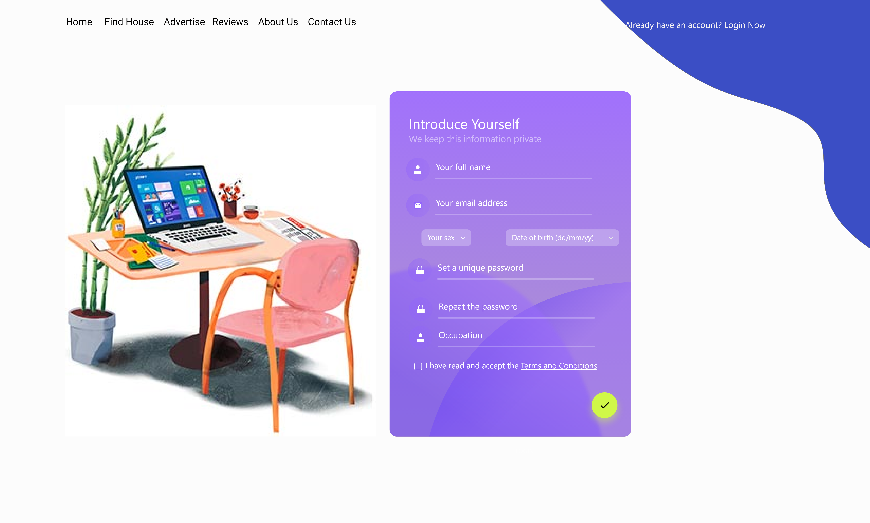
Sign Up Page

Slide 3
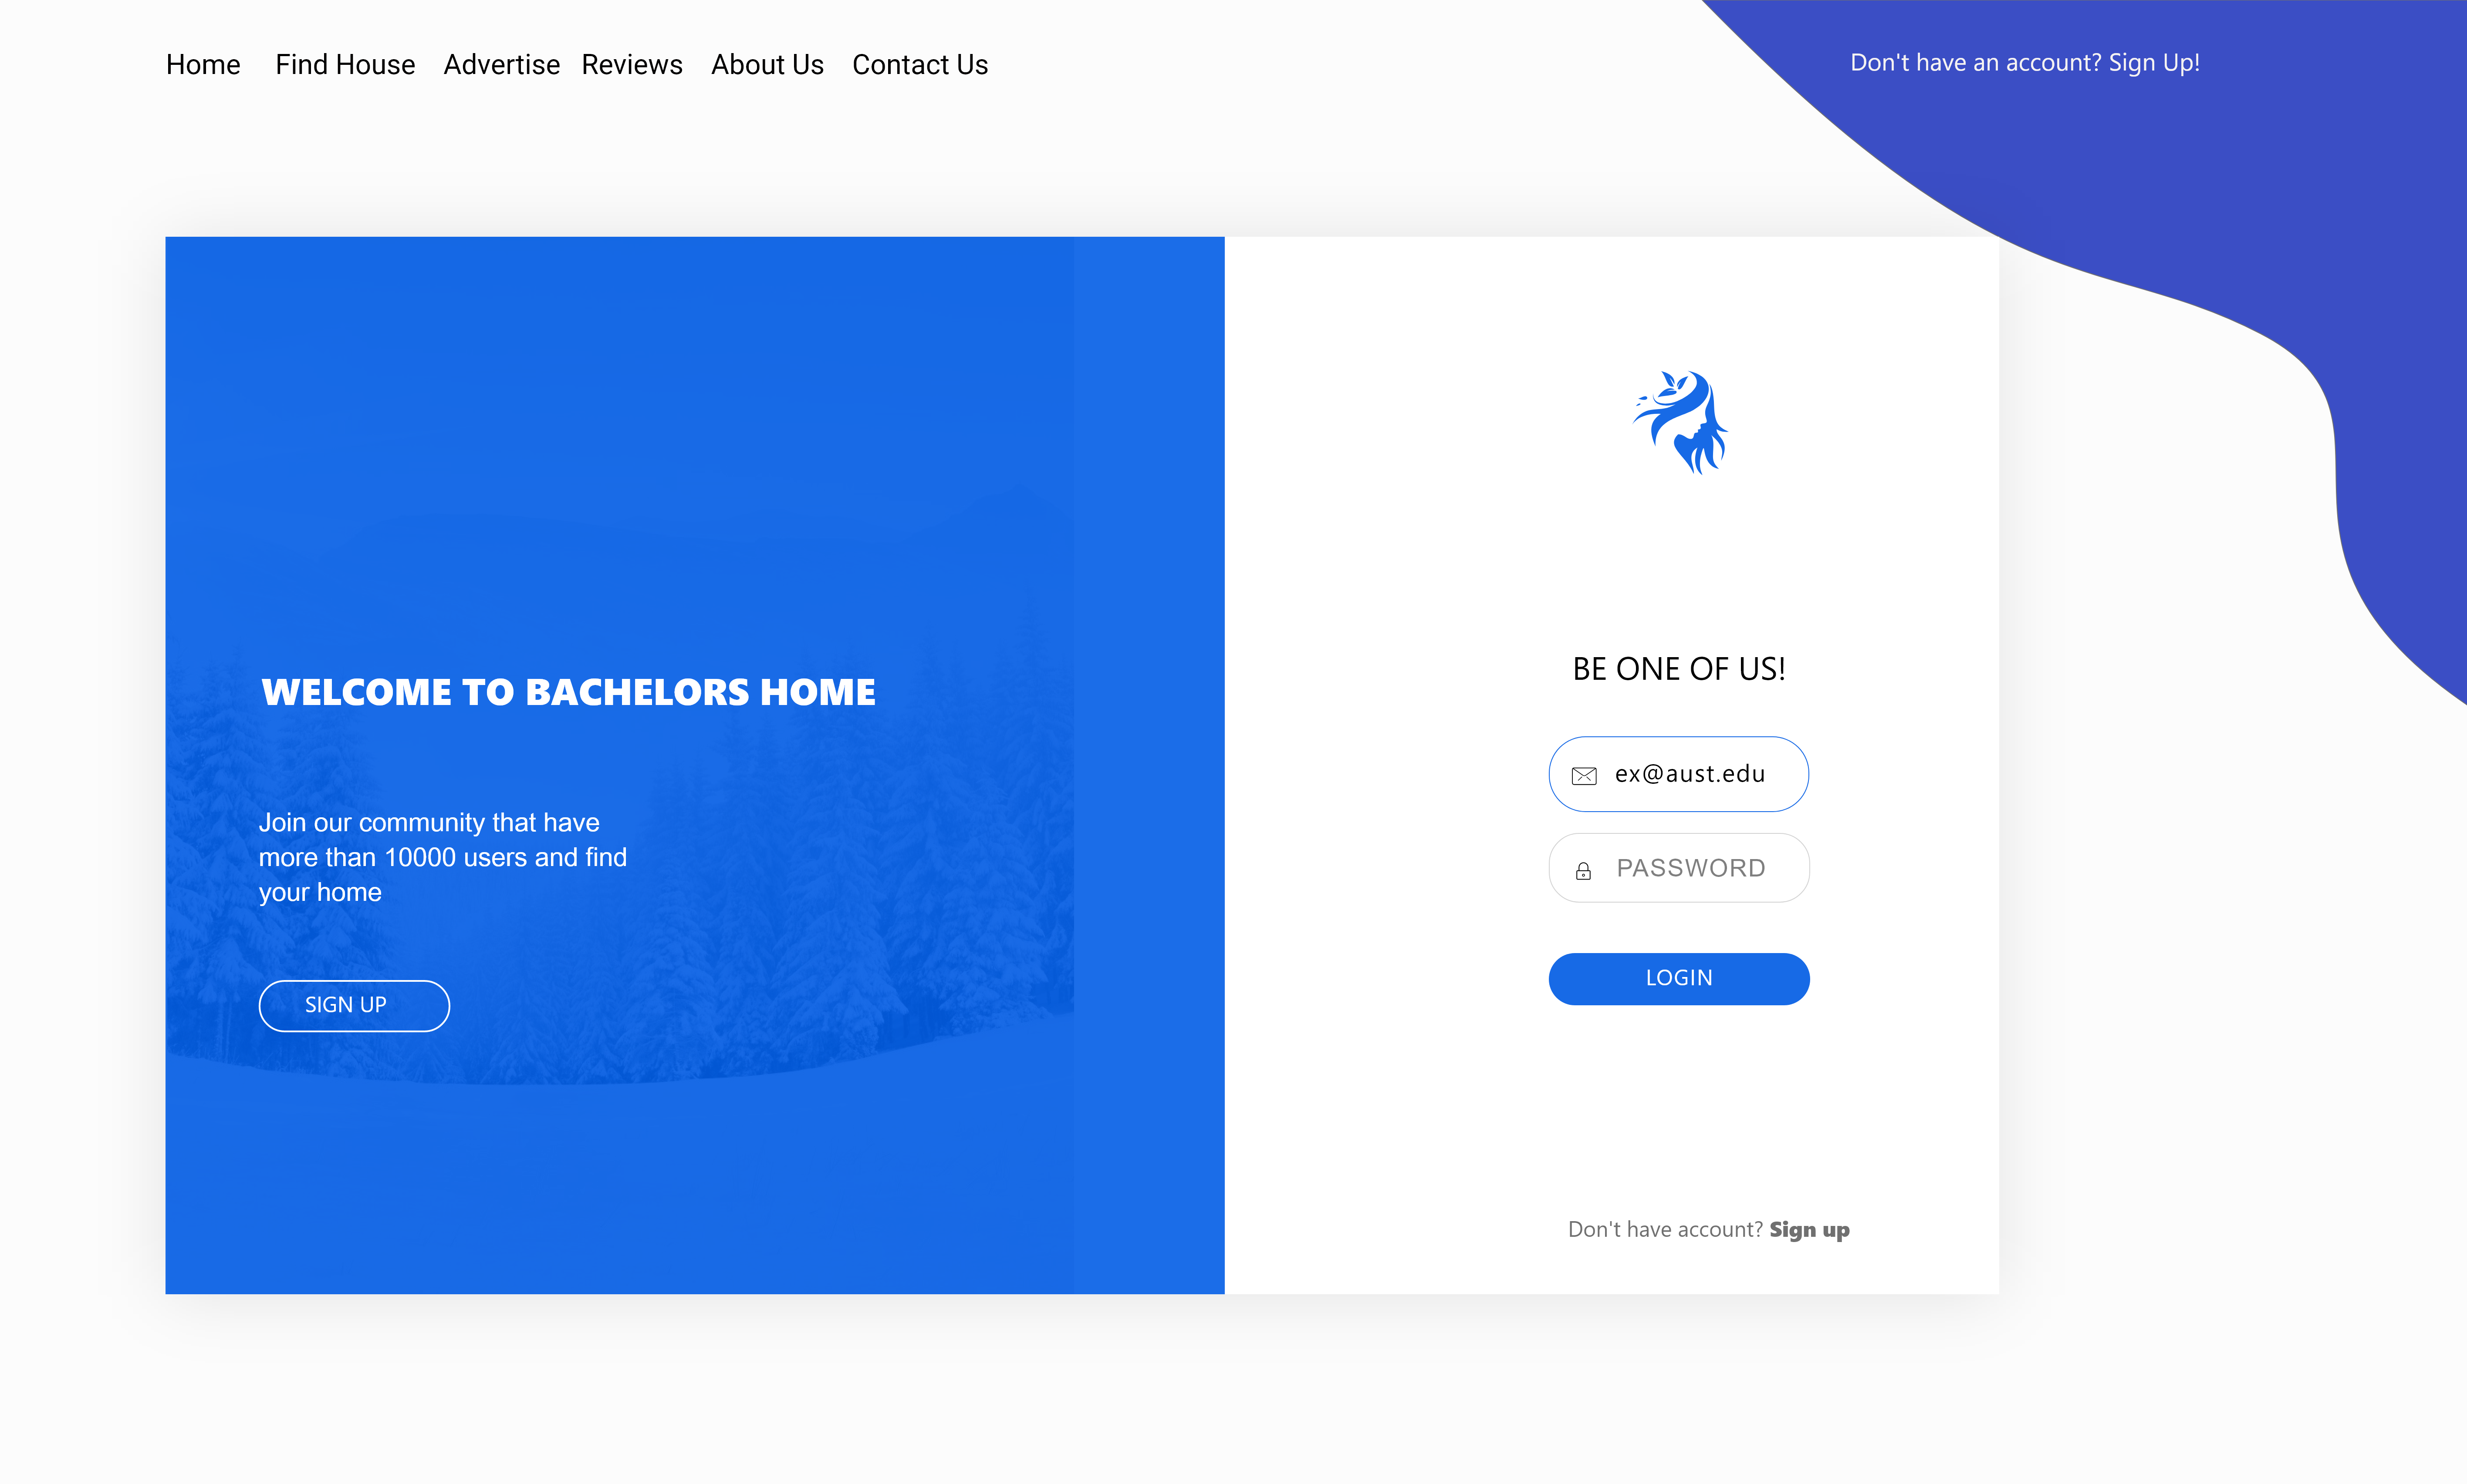
Login Page

Slide 4

Home Page

Slide 5
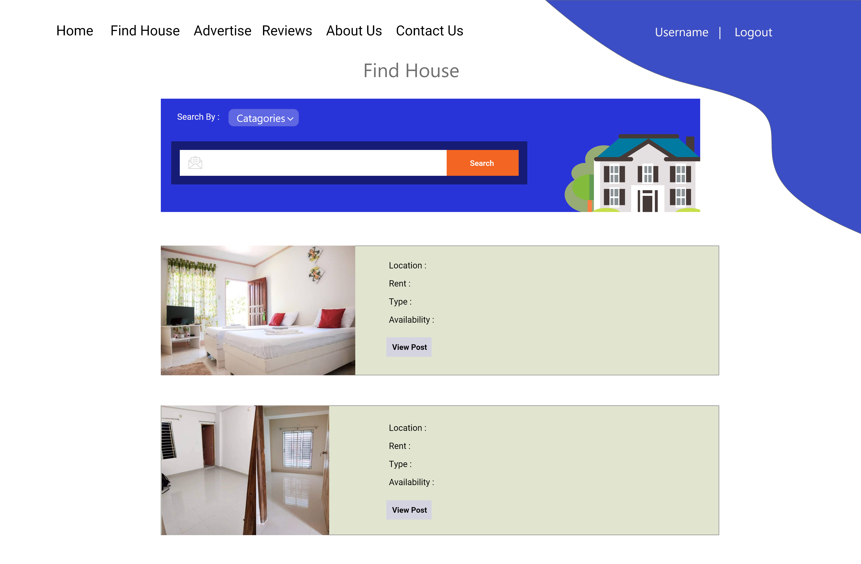
Find House

Slide 6
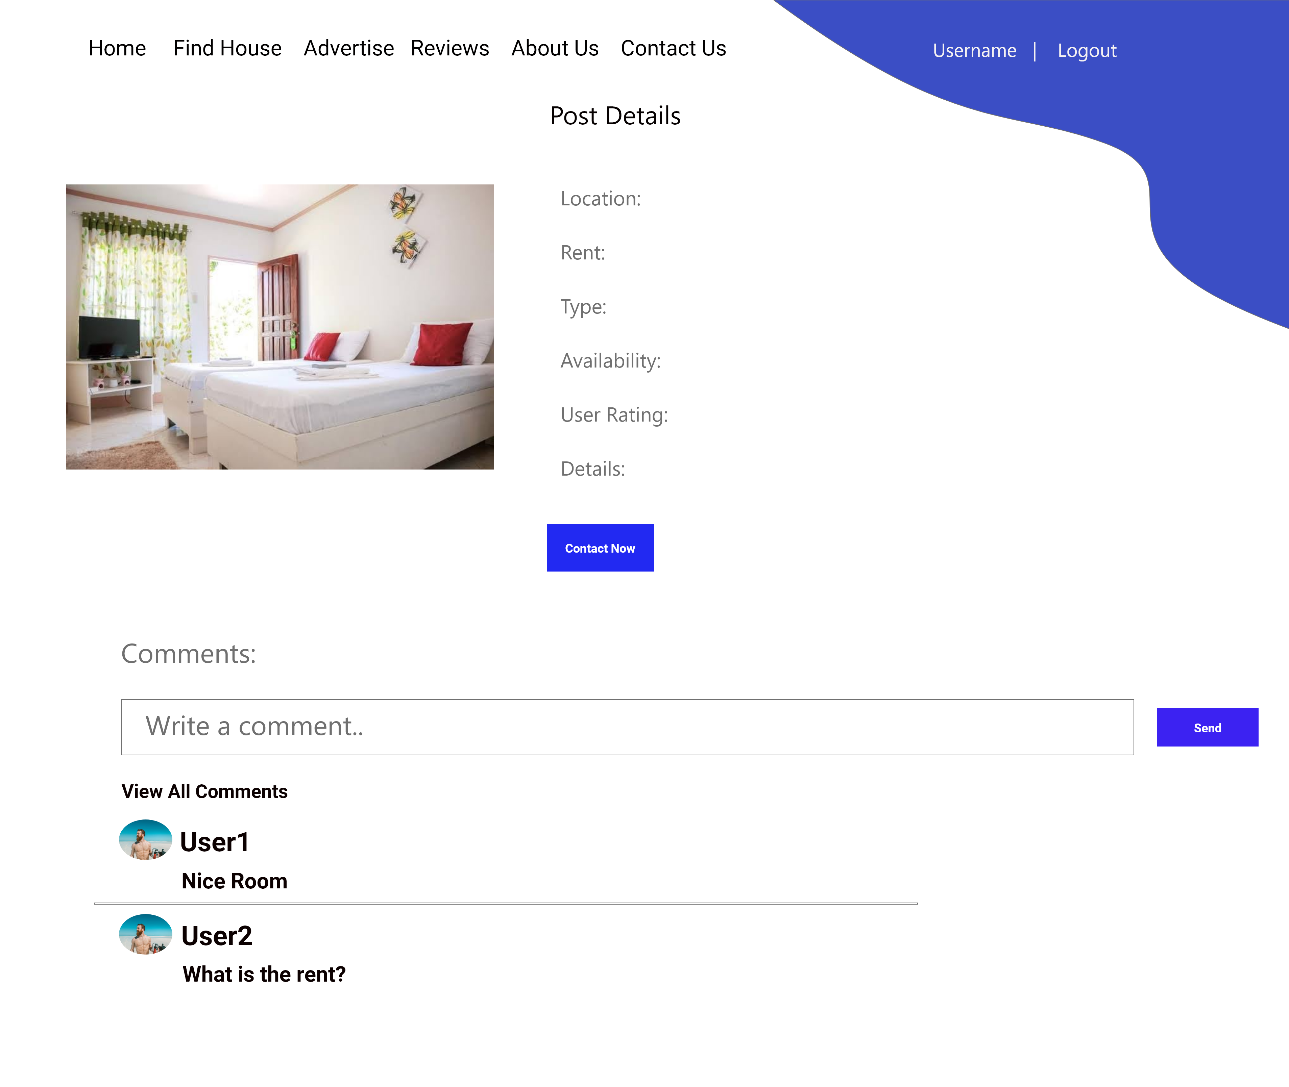
Post Details

Slide 7
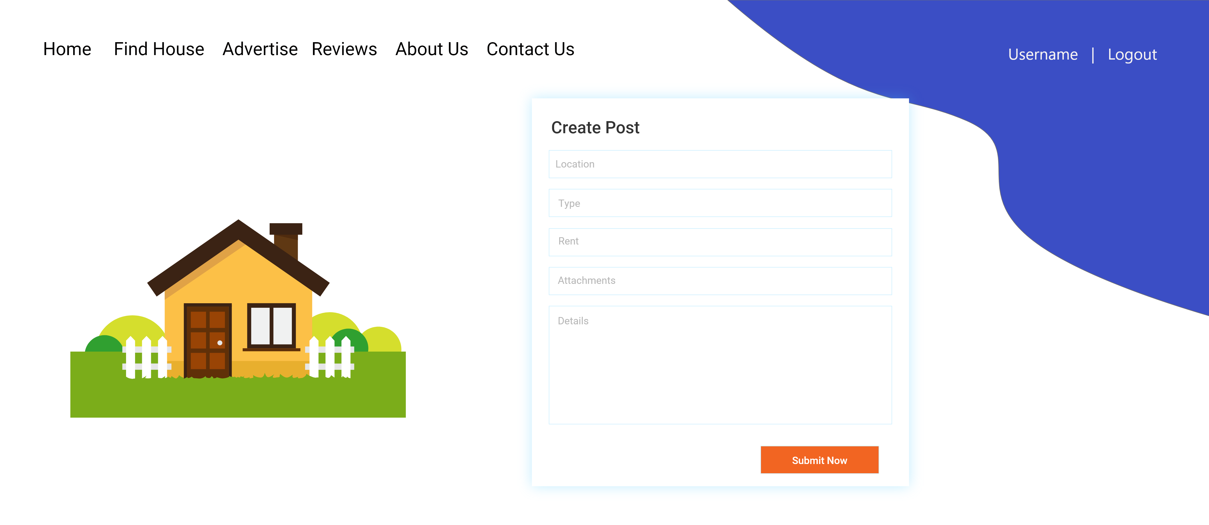
Advertise

Slide 8
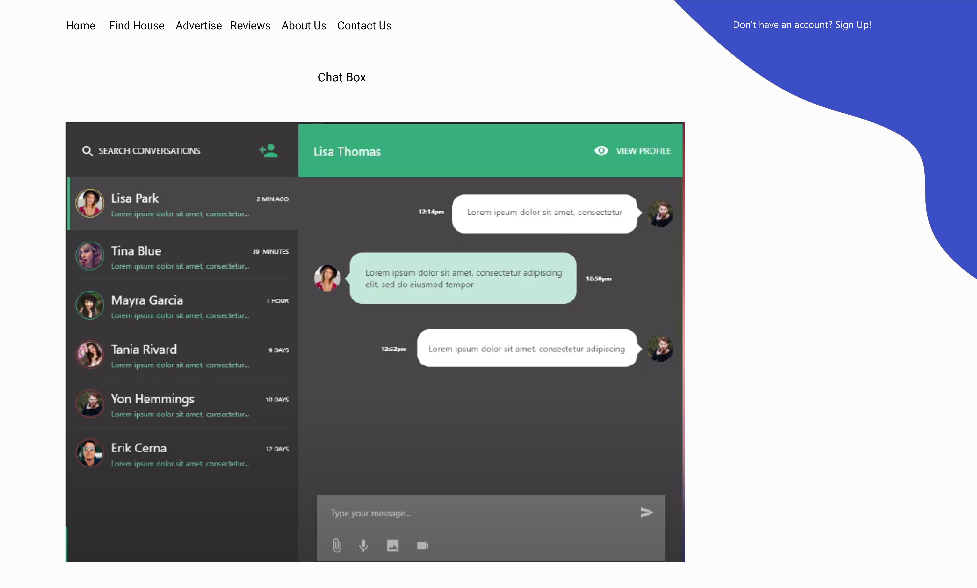
Chat Box

Slide 9
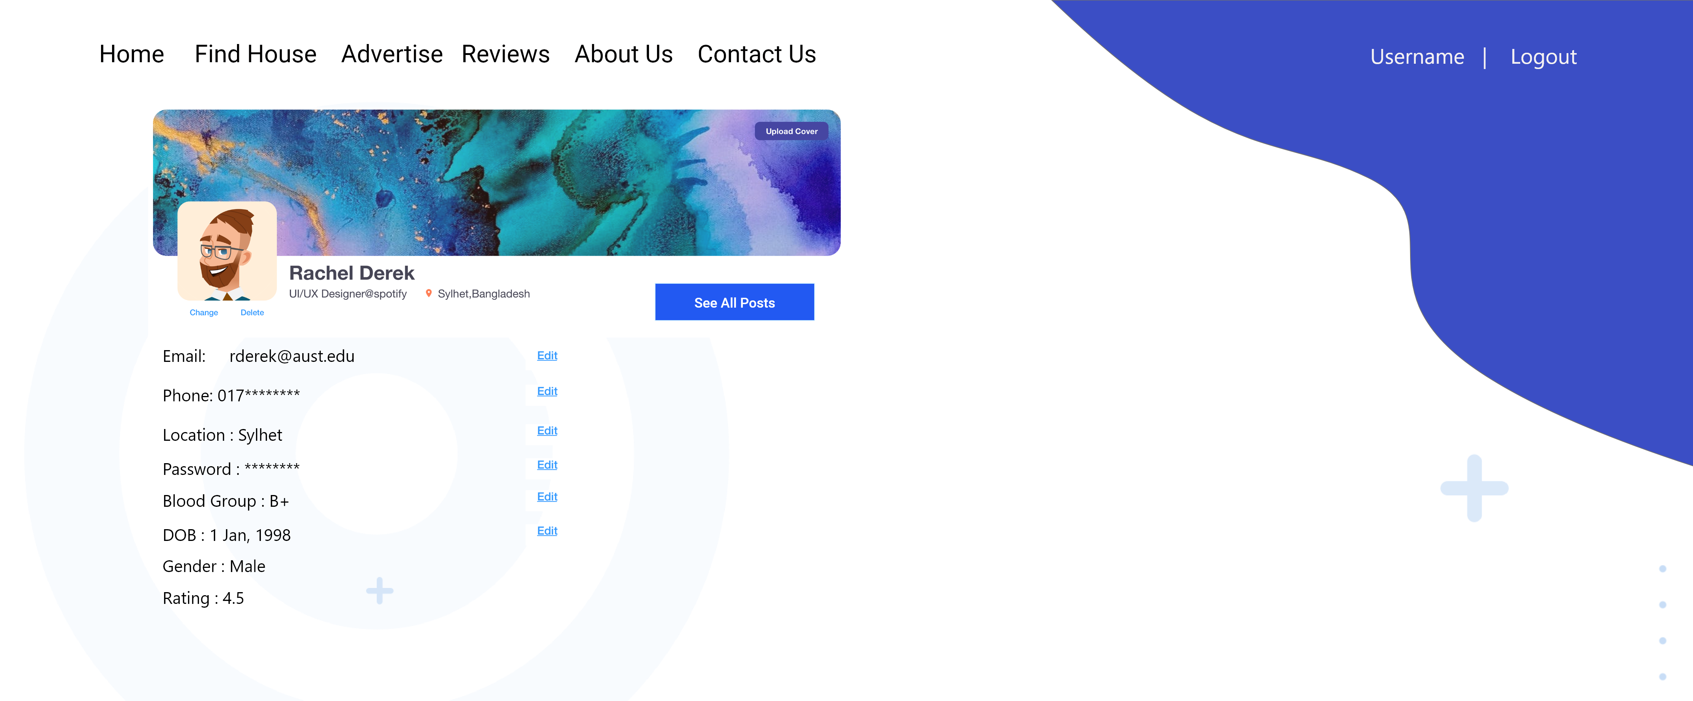
Profile

Slide 10
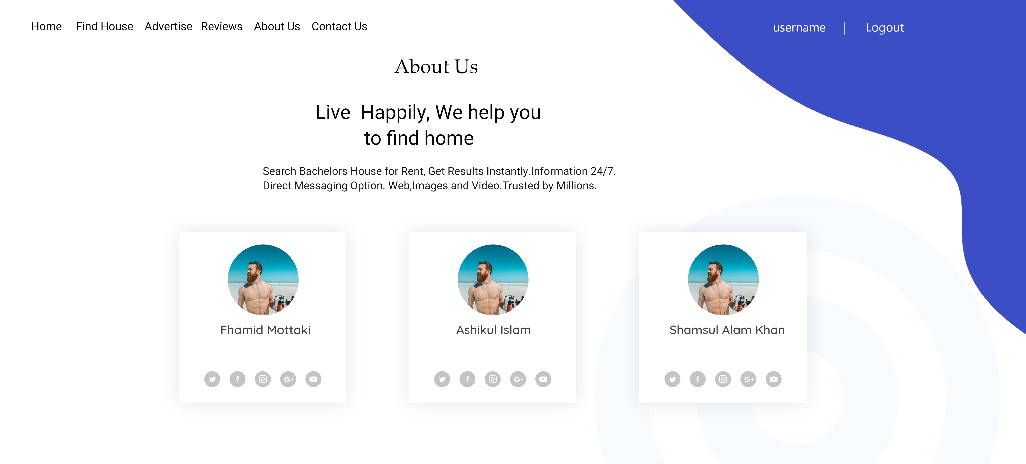
About us

Slide 11
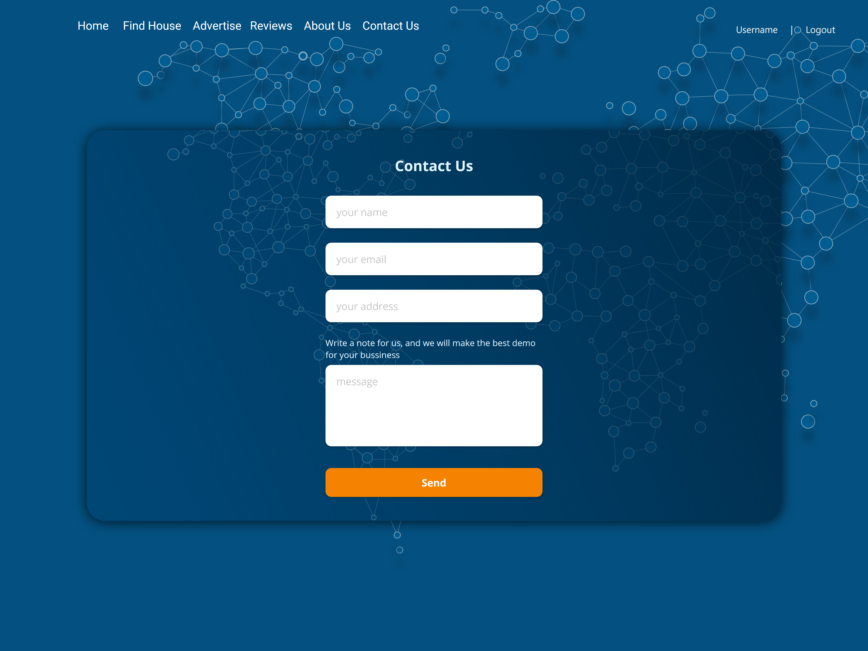
Contact us

Slide 12
Thank You

